Slide 1

Texas A&M University-Texarkana
Budget Contact Training

Slide 2
What is a Budget Contact?
New workday role
Assigns costing allocation during business process for terminations, promotions, new hires, etc…
Coordinates with manager to keep department personnel on budget

Slide 3
Where do I get my info?
Your manager or personnel budget
A search authorization form
Paperwork coordinating with a promotion, job change, allowance or other various business processes
Previous employee costing allocation/the position costing allocation
Notes:
I think we will have to tag team this slide and we will discuss completion of forms and possible training for that at a later date. And when the previous employee/PIN could be wrong.

Slide 4
When will I need this information?
When prompted in Workday
  New hires
  Reclassifications
  Terminations
  Allowance additions or changes
Completing HR forms
When funding changes for an employee (will be a manual process outside a business process)

Slide 5
Terms to Know
FAMIS/Canopy – important to know they are the same system just with a different look; should have same information
PCT – Payroll Cost Transfer; Moves payroll expenses after processed from account to account
DBR – Department Budget Request; moves available funds from account to account

Slide 6
CA – Costing allocation (acronym you might see in an email)
SENC – Salary Encumbrance; transaction batch type in canopy identifying that line as a salary encumbrance transaction
SSV – Salary Savings; transaction batch type in canopy identifying that line as a salary savings transaction
Work-tag – What Workday calls an account

Slide 7
Workday
PIN – Starts with P or N followed by a series of numbers
Used to attach budget information to an employee
PINs starting with 1+ are P, 0 or 8 are N
To find the PIN associated with an employee, go their profile, look on the summary page on the right-hand side
  If no one is currently in the PIN it can be found under the staffing tab of the organization.
If you already know a PIN and want to know who is attached to it, search ‘position: p- or n and the numbers that follow’ in the workday search bar; EX: position: p-116218 or position: n00718

Slide 8
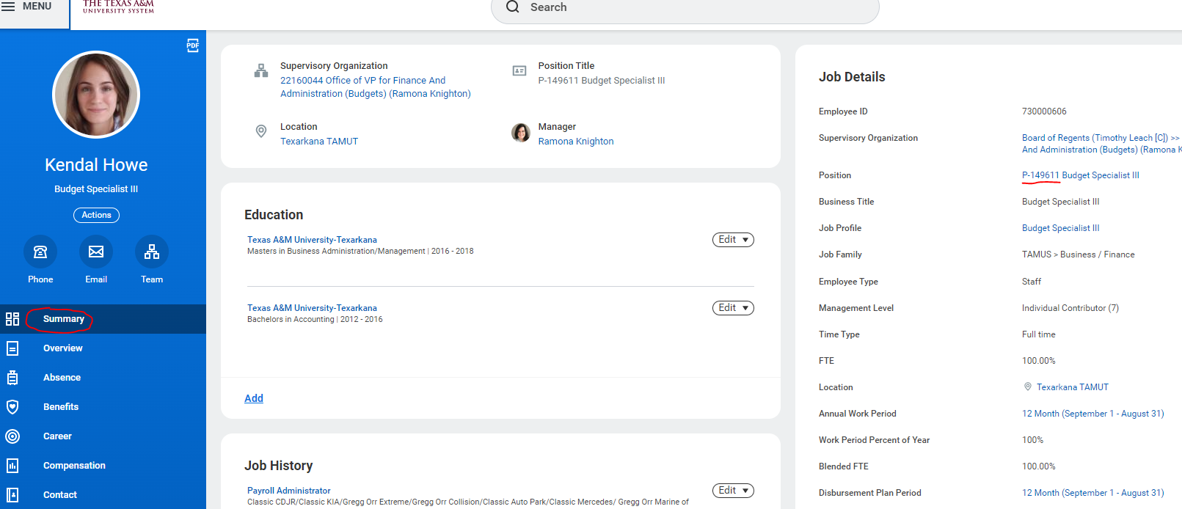
Summary for an Employee

Slide 9
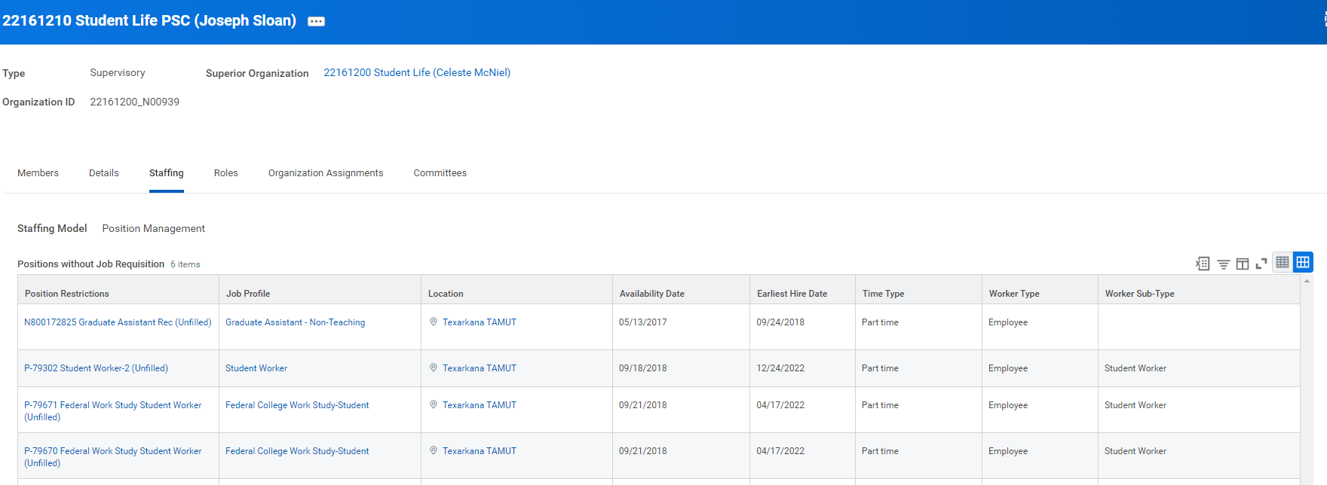
Adloc staffing tab; can get here by clicking on the employees adloc or typing the adloc number in the search bar
Open PINs under adloc

Slide 10
Costing Allocation – tells FAMIS where an employee is paid from
Attached to a PIN and an employee separately – make sure any changes are only to the worker position and NOT position restrictions
Follows budget created at beginning of FY by Department heads and Budget department
To find an employee’s CA go to their profile, the pay section in the blue menu on the left, and ‘costing allocation’ tab across the top menu

Slide 11
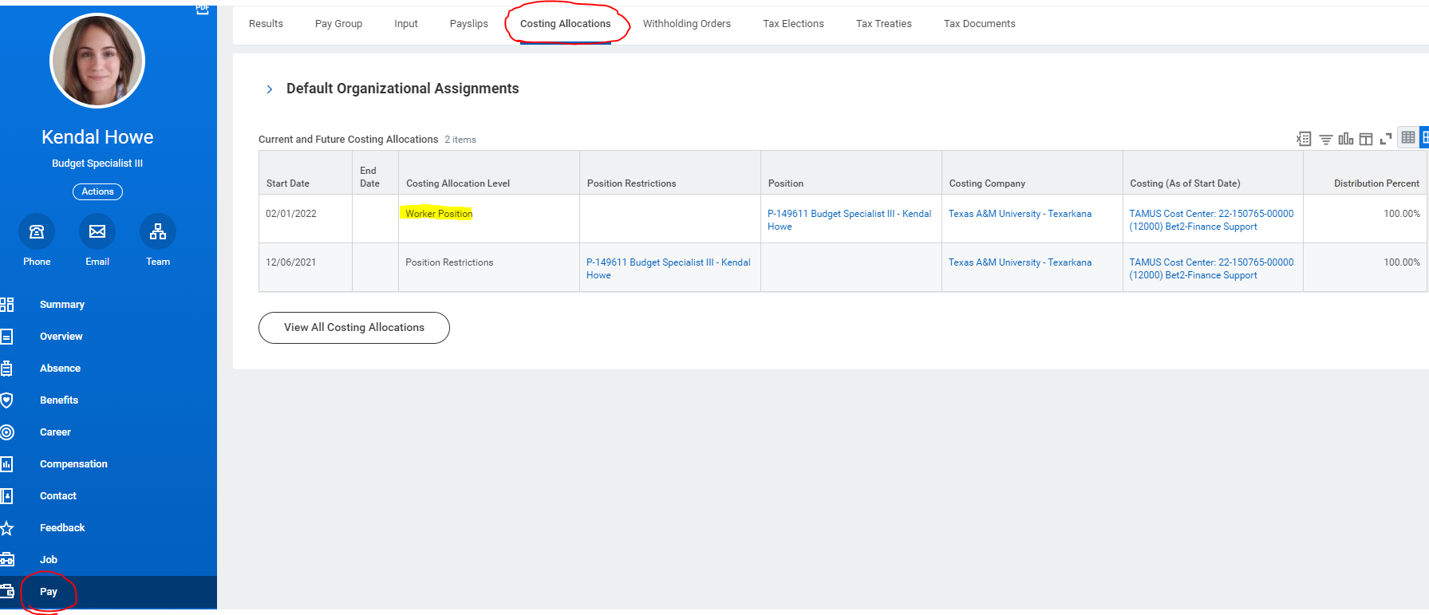

Slide 12
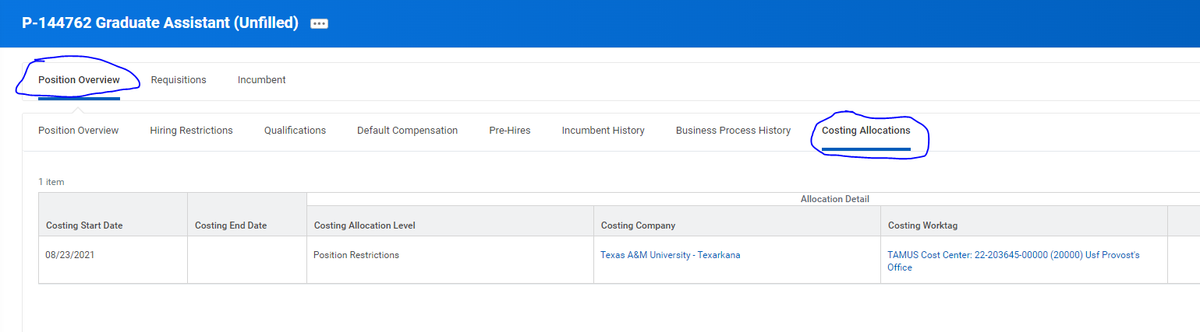
If you want to see where a position was paid from in order to pay a new hire from there as well, type ‘position: the position’ in the search bar to get to the PIN itself. Go to the costing allocations tab from the overview and see where the PIN has been historically paid from (you can also look in CANOPY)

Slide 13
Costing Allocation Tips
Always remember the account must be prefixed with 22-account #
  Any other number means you’re trying to use another system member’s accounts so make sure to look out for this
End dates are only entered in a costing allocation line when you are immediately putting in a new account
  When doing a new account, the end date of the old CA and begin date for new CA must always be back-to-back.

Slide 14
When prompted, what do I do?
For hires, you will ALWAYS enter a costing allocation.
For terminations, submit the workday to-do; no changes needed for the PIN. It will be updated by budget/HR
For reclassification:
  Increase in pay MAY have a change
  Switching of PINs will REQUIRE one
  No increase in pay and same PIN, submit to do and make no change

Slide 15
Canopy
Payroll tab(s) – allows search by PIN, UIN, and Account; where you go to do PCTs
Find account employee is currently paid from: canopy, payroll, payroll inquiry, by UIN – search last name if UIN unknown

Slide 16
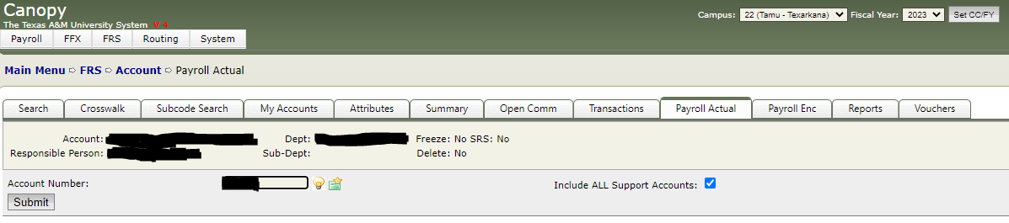
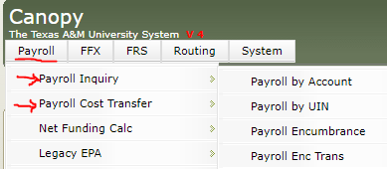
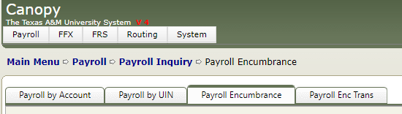

Slide 17
Contacts
HR – hr@tamut.edu; for issues with costing allocations themselves and workday inbox steps
Budget – budget@tamut.edu; for account(s) if you are unable to find the old information or with canopy help

